Slide 1
RacLab
The causal role of the somatosensory cortex in prosocial behaviour
eLife; 2018
Yang Ziyang
2025.4.24

Slide 2
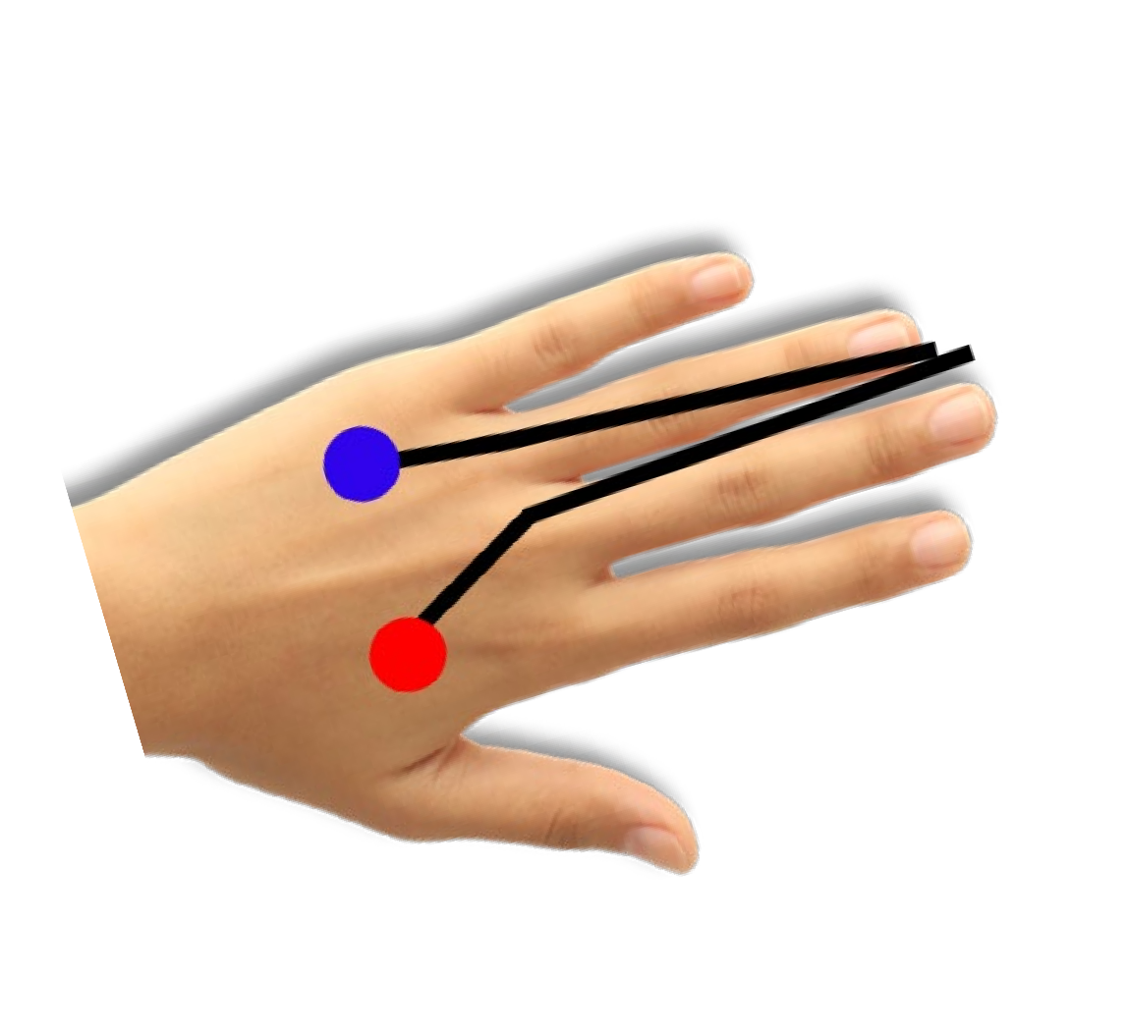
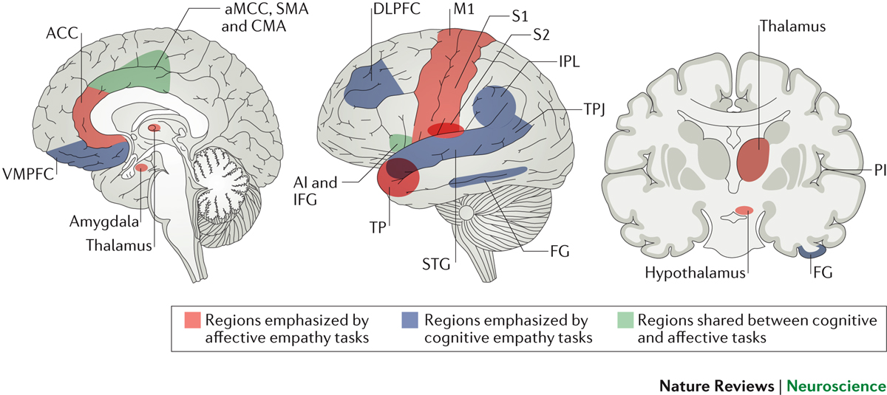
Introduction
abstract symbols
injured body
情感网络
躯体网络

Slide 3
Introduction
somatomotor S1/M1
First-hand pain
allow empathy and accuracy in perceiving other emotions

Slide 4
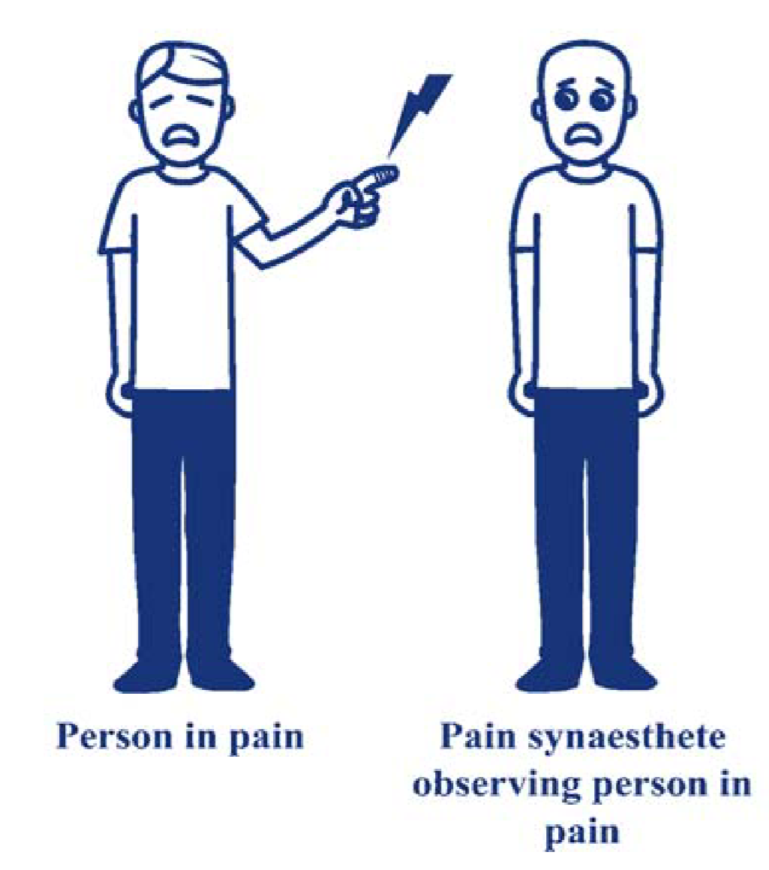
Introduction
Pain
Distress
Prosocial behavior

Slide 5
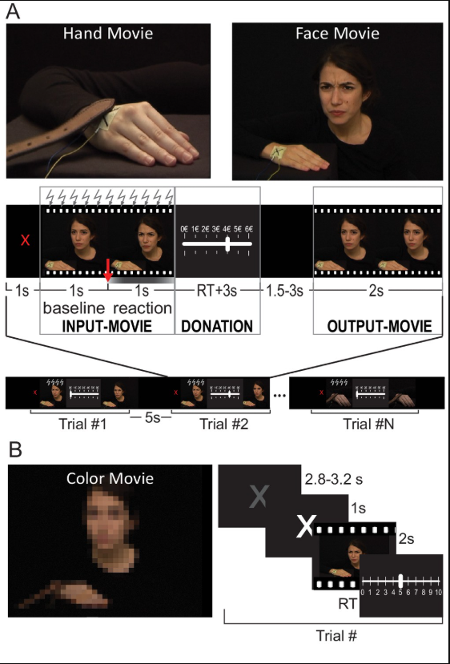
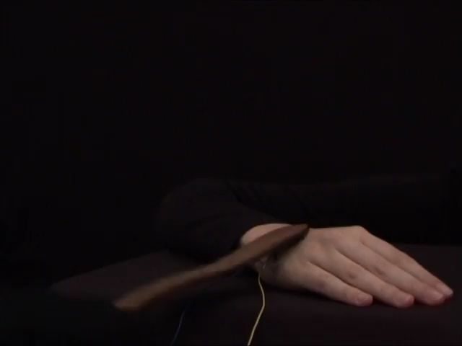
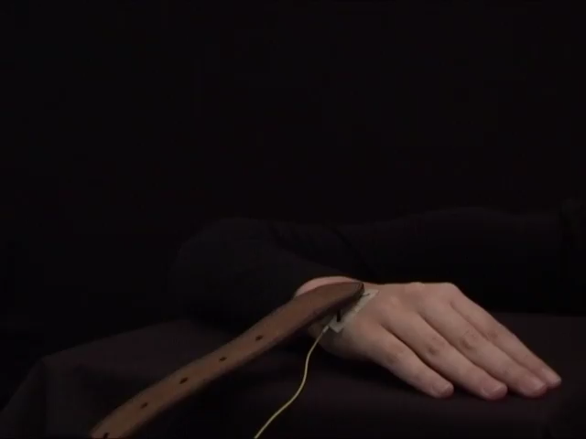
Desigh
Hand condition (dSI)

Slide 6
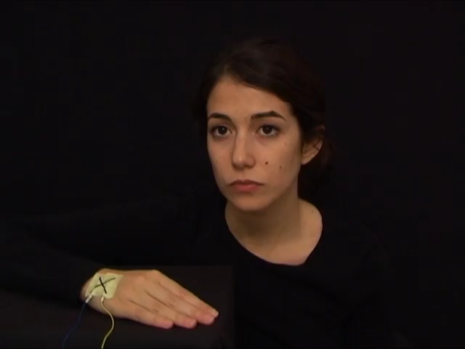
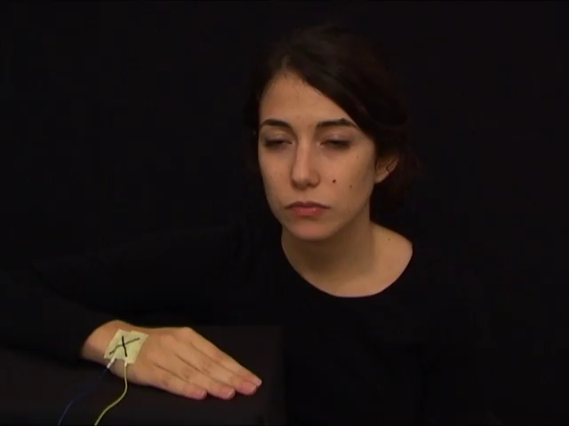
Desigh
facial condition (vSI)

Slide 7
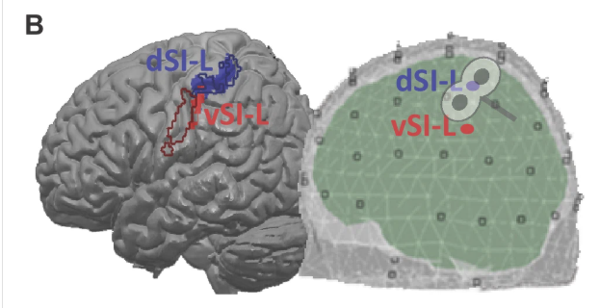
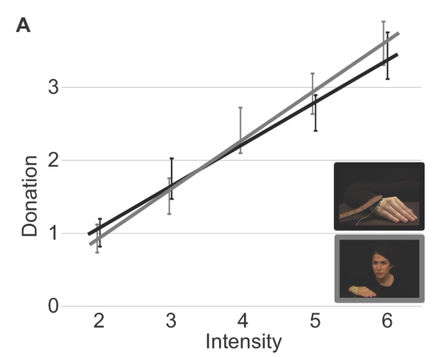
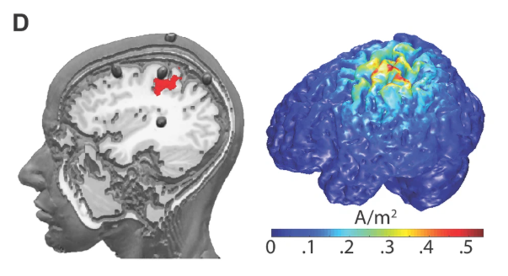
Result

Slide 8
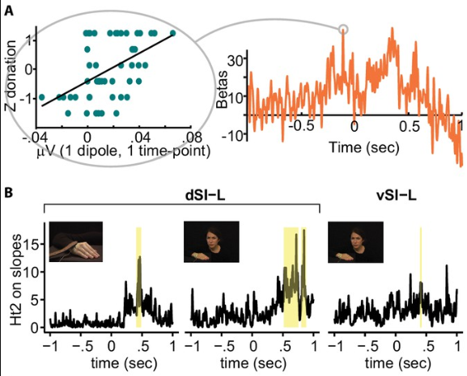
Result
fMRI EEG
Hand condition (dSI)
facial condition (vSI)

Slide 9
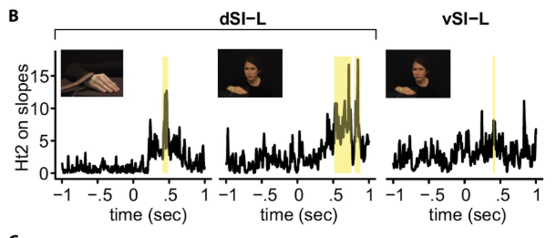
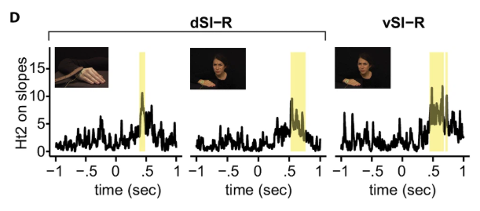
Result

Slide 10
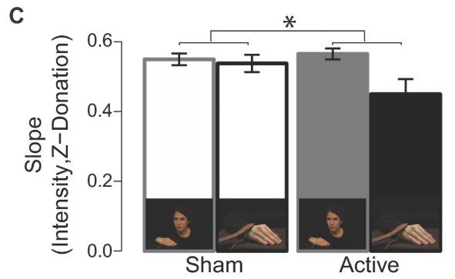
Result
active rTMS on SI significantly flattened the relationship between intensity and donation only for the Hand condition

Slide 11
Result
a facilitatory effect on the hand region of SI
a weaker inhibitory effect on ventral SI
tDCS on SI significantly improved the relationship between intensity and rating for the Hand condition
a trend for reduction in the Face condition (p = 0.07)
lack of effect in the Color conditio

Slide 12
RacLab
Distinct fMRI patterns colocalized in the cingulate cortex underlie the after-effects of cognitive control on pain
NeuroImage; 2024
Yang Ziyang
2025.4.17

